Slide 1
Life Returns to the Mountain
Class Activity
based
on
Gopher to the Rescue! A Volcano Recovery Story
by
Terry Catasús Jennings
Visual Aids for Teacher Materials
Presenter Notes included
Notes:
YOUNGER STUDENTS
Teacher guide=concepts
PPT pictures
Worksheets
Take out your plant worksheet
This activity is for younger students.
Have a teacher guide
Gives you the concepts you should discuss with your students
This ppt gives you pictures you can show them.
Filling in worksheets is activity. We’ll do that activity

Slide 2
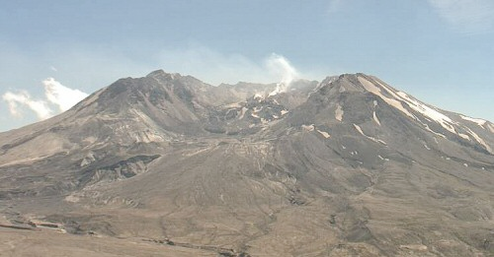
Mount St. Helens After Eruption
Notes:
This is the way Mount St. Helens was after the eruption
Gray, Crusty Ash.

Slide 3
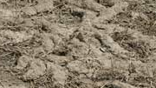
Gopher Tunnels
Notes:
But we know gopher survived, and he started making tunnels.
The tunnels broke up the hard crusty ash and brought up dirt from below.
They brought up bacteria from under the surface that made the dirt on top very nutritious, fertile
(Any plant that falls on the gopher tunnels will have place to send out roots and food.
Some Islands of life surfed down the avalanche
What we’ll be doing is a representative slice of what happened to show students the idea of how plant and animal life returned to the mountain. You can break the activity into two lessons.
Need to remember that it was not a sequential recovery. First this happened, then this happened.
It was more of a jumble and happened at different rates in different areas.

Slide 4
What Do Plants Need to Come Back to the Mountain?
A place to send out roots
Food
Sun or Shade
Water
Notes:
A place to send down roots I equate to shelter for an animal.
Food the gopher provided, or fertilizer, because the ash was sterile.
Sun or shade depends on plants. Some actually need shade
There was no difference in the amount of rain because of the volcano, so water is moot point

Slide 5
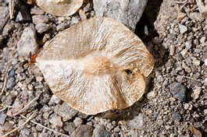
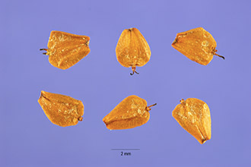
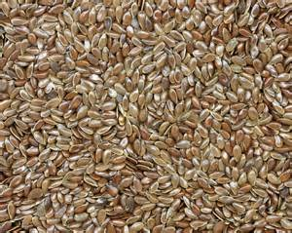
What Blew In On the Wind
Black Cottonwood Seed
Deciduous Tree
Red Alder Seed
Deciduous Tree
Any Old Seed
Notes:
So right away, seeds are blowing in the wind. Coming from places that weren’t damaged, like the Black Cottonwood and Red Alder which lived on parts of the mountain before the eruption.
They are deciduous. They need sun to sprout.
And places that are far, far away—any old seed. Fur little bushes and brush.

Slide 6
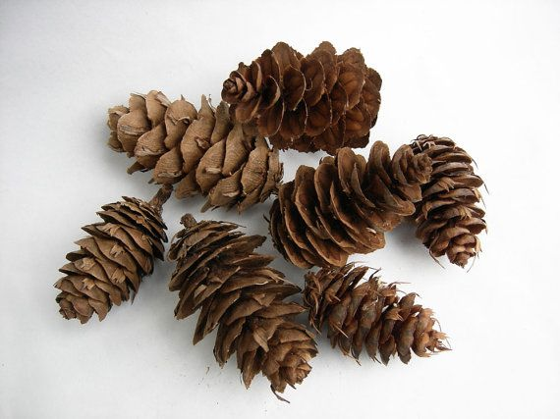
What Did Not Blow In On the Wind
Notes:
What did not blow in on the wind was the seeds of coniferous trees like hemlocks and firs
Had to depend on animals to disperse the seeds.
They also need shade to sprout

Slide 7
Right After the Eruption
Notes:
Right after eruption
Gopher
Elk
So take out your form that looks like this.
So let’s look at what happened and bring plants back to the mountain.
After the eruption in many parts of the mountain gophers came out and dug tunnels.
In a few, very few, parts of the mountain, there were islands of life, but we’ll just look at this little part of the mountain.
Elk visited. Elk’s hooves broke up the ground. Now seeds that blew in could have a place to send down roots.

Slide 8
Right After the Eruption
Notes:
Elk Dropped Fertilizer
And now, in some of elk’s footprints, we not only have a place to send down roots, but food too,
Color in some fertilized hoof prints

Slide 9
Weeks After the Eruption
Notes:
Spring Time
What’s happening?
What will happen to seeds?
Put them in
not all become plants
Seeds fall onto the Mountain the first day.
It’s spring time.
Seeds that blow in the wind.
If lands in right place, sprouts
Put seeds in some of the possible places where they could land, but not all.
Every seed that lands does not become a plant!

Slide 10
End of Summer
Notes:
End of summer
What has happened?
More Tunnels/Elk
More gopher tunnels, more hoof prints with fertilizer
Put those in.

Slide 11
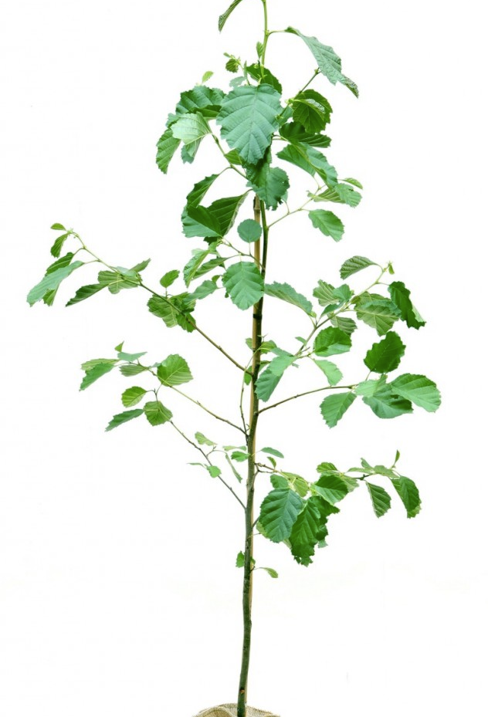
End of Summer
Notes:
What happened to plants?
Deciduous?
Conifer seed
Can it sprout?
Put them in
Grow Plants
We even have some tree saplings,
Deciduous because can sprout in the sun.
Elk will probably bring in the seed of a conifer tree in its gut. These are hemlocks and cedars and firs, trees like Christmas trees
Put in conifer seed inside one of the elk hoof prints.
But can it sprout?

Slide 12
Second Summer
Notes:
The second summer, a year later,
What has happened?
Everything has grown.
More deciduous trees, more shrubs grown in gopher tunnels.
Grow Trees. Add another deciduous tree or so.
Add shrubs in places where there were no gopher tunnels and no elk hooves.
What do you think can make the ash softer?
Rain wears down the ash and softens it.
And what about that conifer seed? It has shade now. Do you think it can sprout now?
So let’s grow that conifer seed into a seedling.

Slide 13
Years Later
Notes:
More years
What has happened?
Five years later, the low lying bushes are growing. And the deciduous trees are growing, and the conifers are growing.
So make everything grow. You can add more of everything.

Slide 14
10 Years Later
Notes:
Ten years later,
What has happened?
Grow them
more dense low lying bushes,
conifers are slow growers.

Slide 15
In the Future
Notes:
Not yet, but there will be a time in the future,
What do you think will happen?
when the conifers grow taller than the deciduous alders and cottonwoods.
They are shading them out.
Can you see the deciduous trees?
They’re dying.
The conifers will once again be the kings of the forest.
They were there first.
And they will be there once the ecosystem has recovered. But the cottonwoods and alders made it all possible.
This is what we call succession.

Slide 16
Animals Return
Notes:
You can break the activity here.
You can also mix the animal part of the activity with the plant part.
Take pictures of the animals and as they are able to go back to the habitat, have the students glue them on.
Or do a their activity: Let them, now that they know, draw what the mountain would have to look like for a particular animal to return.

Slide 17
What do Animals Need to Live to the Mountain?
Shelter to sleep, rest, get out of the sun, and hide from predators.
Food
Places to nest
Notes:
Water
predator/prey
Small legs
When you ask students the question, water will inevitably come up. After a short period, water was fine at Mount St. Helens. Rivers, creeks and lakes changed course, or were filled and new ones created, but there was potable water and there was rain.
Discuss with students about predator/prey interactions. Predators need to get more energy (food) from hunting than they spend in the hunt. So Eagles and bobcats will stay in the periphery until their prey moves into the mountain.
Animals have food preferences just like we.
Elk prefer to eat conifers, they’ll stay out where the conifers are.

Slide 18
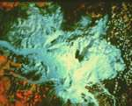
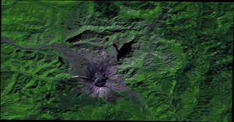
30 years later
May 1980
Notes:
We already saw these pictures of Mount St Helens after the eruption and thirty years later.
This is the opportunity to tell your students of the area that was crusted over with ash.
The damaged area was 24 square miles.
Discuss with your students about how squirrels and rabbits and other small mammals have small legs and can’t go into the damaged area. They have to wait until the vegetation creeps up the mountain as the vegetation recovers. And the conifers crawl up the mountain as well because their seeds fall at their feet. Need animals to disperse it here.

Slide 19
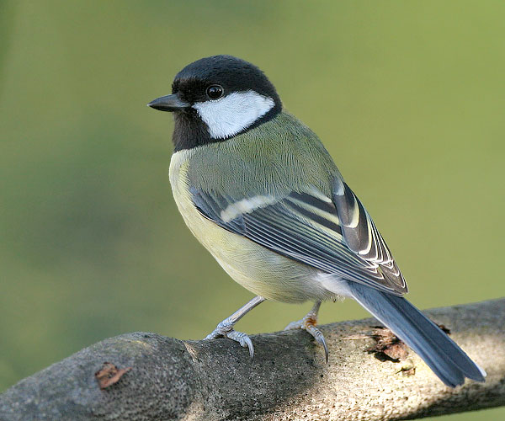
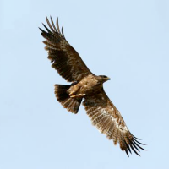
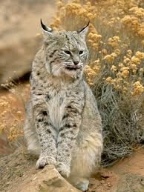
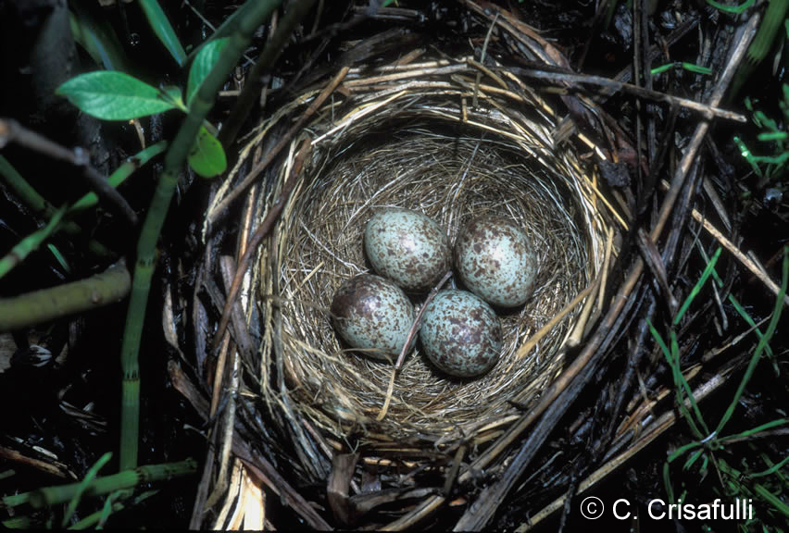
Right After the Eruption
Visit
Live
Notes:
So Right after the eruption discuss with your students which animals were able to visit the mountain?
What do we know?
We know that elk were there two days later,
Birds, since they’re on the wing, would fly over
Half the insects in the world are airborne at any one time. Some carried in wind, some flying.
Squirrels and rabbits are too small to travel long distances without food or shelter, so they stayed on the outskirts that were not damaged. They didn’t even visit.
Predators for squirrels and rabbits would stay on the outskirts with their prey

Slide 20
Right After the Eruption
Visit
Live
Notes:
Discuss with your students whether each animal will find food, shelter and a place to nest in the habitat
Why can the gopher stay on the mountain?
What does the book say it eats?
Did it have shelter and a place to nest?
Does any other species have food, shelter and a place to nest?
What do Squirrel and Rabbit do?

Slide 21
Weeks After Eruption
Visit
Live
Notes:
Discuss with your students whether things may have changed in a few weeks.

Slide 22
Weeks After Eruption
Visit
Live
Notes:
Animals with long legs and wings can visit, but no one can stay to live.
No food, shelter or place to nest for any animal

Slide 23
End of Summer
Visit
Live
Notes:
Remind students what the vegetation has done at the end of summer
Who has food and shelter
Discuss which animals have food, shelter and nesting places by the end of summer.

Slide 24
End of Summer
Visit
Live
Notes:
Who could live?
Some bugs may fall into the patches of vegetation and be able to eke an existence.
Birds, even ground nesting birds would not come. There is not enough vegetation to hide from predators, not enough bugs to eat in the few green patches.
We know squirrels and rabbits wouldn’t be able to walk.
Elk walk, but there’s no place for them to rest and get out of the sun. They need to eat lots of conifer needles.
Eagles and bobcats stay out. If the prey isn’t plentiful, predators won’t waste the energy.

Slide 25
Second Summer
Visit
Live
Notes:
Remind your students what the vegetation has done.
Discuss again what animals may be able to return to live on the mountain.

Slide 26
Second Summer
Visit
Live
Notes:
After a year, things haven’t changed too much, but a ground nesting bird might feel safe nesting on the mountain in some areas. Some may feel like it’s safe enough. There are more insects now. There are also birds which fly in and have a little snack, but don’t choose to stay yet.

Slide 27
Years Later
Visit
Live
Notes:
Remind your students of how the vegetation has progressed
Discuss which animals may now have what they need to return to the mountain

Slide 28
Years Later
Visit
Live
Notes:
Tree nesting birds now have food, shelter and places to nest
Once the birds’ can come back, their predators can come back once there are enough birds and other prey for them to eat, and they have places to nest. There may not be enough places for eagles to nest.

Slide 29
10 Years Later
Visit
Live
Notes:
Discuss with your students how the vegetation has changed
What animals may be now able to live on the mountain

Slide 30
10 Years Later
Visit
Live
Notes:
By ten years later, according to Mount St. Helens scientists, elks, birds, small mammals, were all represented back on the mountain. Predators followed prey. So the bobcat and the eagle followed the birds and small mammals.

Slide 31
Review
Notes:
What do plants need
What do animals need

Slide 32
Recovery was not sequential, but a jumble
Still going on
Mountain will continue to change
Perhaps another eruption
It is still not back to where it was before the eruption
The tree line has been pushed down the mountain more than a thousand feet
All times are approximate.

Slide 33
WRITE!
Notes:
Ask students to write a paragraph

